Slide 1
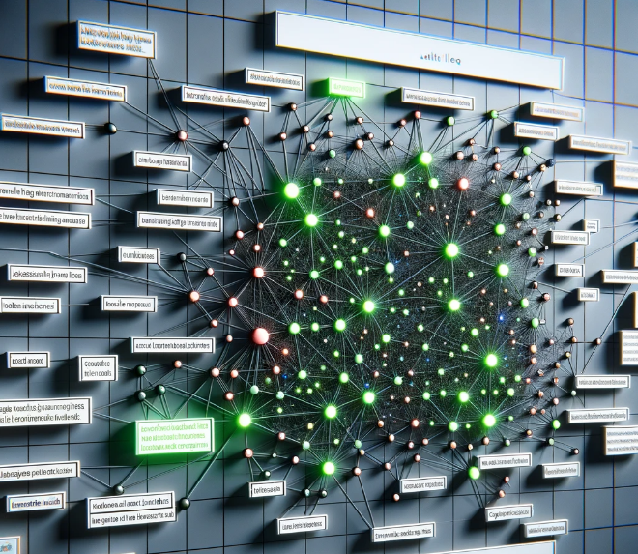



LLM for Fake News Detection
Presenter:
Group 6 member: Erdong LIU, Haihong ZHAO, Kainan LIU
Notes:
Hello everyone, today our group 6 will present our final project. I am the speaker , and our group members are also Haihong Zhao and Kainan Liu .

Slide 2


Overview:
Dataset Collection and Preprocessing
Fine-Tuning
Evaluation
App Demo Building
What we learned
1/10
HKUST(GZ) | Outline
Notes:
Overview
1. Our first step is dataset collection: a news detection dataset constructed from relevant task literature, which directly offer claims and their relevant evidence. Then we perform preprocessing: we convert the two Json files, LIAR-RAW and RAWFC, to the data format of the deepseed training framework. : {prompt, chosen, rejected} 2. In the fine-tuning step, we mainly adjusted the text data to the appropriate prompt command: {Below is ......}, then set the fine-tune parameter and wrote the framework code for the training logic. 3. After two days of fine-tuning, we evaluate the model and compare the metrics before and after fine-tuning to get a more satisfactory result.4. At the same time, we built the app demo, designed the UI after research, and added the evidence chain search function to improve the user convenience.

Slide 3
Data Collection
Selection
[1] A Coarse-to-fine Cascaded Evidence-Distillation Neural Network for Explainable Fake News Detection
News ID: 3652
Claim: President Barack Obama took exactly none of his own deficit reduction commissions ideas. Not one.
Evidence: If Boehner had offered a more measured assessment, he would have had a fair point about the differences between Obama’s fiscal approach and that outlined by the commission. The president certainly could have gone further in embracing the recommendations of the panel he had commissioned. But he did embrace a wide variety of them, so to say bluntly, as Boehner did, that Obama "took exactly none of his own deficit reduction commission’s ideas" is simply not correct.
Label: False.
Prompt: Below is an instruction that describes a fake news detection task. Write a response that appropriately completes the request.\n\n### Instruction:\n There are a piece of evidence that `If Boehner had offered a more measured assessment, he would have had a fair point about the differences between Obama’s fiscal approach and that outlined by the commission.’ and a claim that ` President Barack Obama took exactly none of his own deficit reduction commissions ideas. Not one.’ How about the veracity of this claim? True or False. If possible, please also give the reasons. \n\n### Response:.
Chosen: According to the given evidence, we think that the claim is False.
Rejected: I don't know.
Processing
2/8
HKUST(GZ) | Data Collection
Notes:
We obtained the two explainable fake news datasets constructed by the literature, known as the "A Coarse-to-fine Cascaded Evidence-Distillation Neural Network for Explainable Fake News Detection", datasets which is publicly available

Slide 4
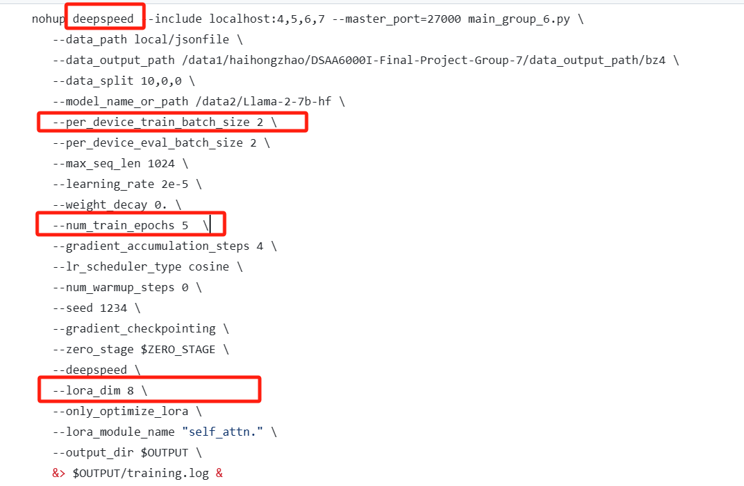
Fine-tuning Details
Parameter
Demo deployment platform: local site - RTX 3090
Device: 4 RTX4090 GPUs
3/8
HKUST(GZ) | Fine-Tuning Details
Notes:
The next part is our implementation details. The training parameters are shown by this figure. Concretely, we use the llama2_7b model in Huggingface library for the base model. Then, we fine tune the base model via four RTX4090 GPUs. The maximum input sequence of our model is 1024, and the training batch size is 2。

Slide 5
Evaluation
True or False
 | Before Fine-tuning | After Fine-tuning
Accuracy | 0.783 | 0.872
Recall | 0.949 | 0.927
True or False or Unknown
 | Before Fine-tuning | After Fine-tuning
Accuracy | 0.297 | 0.873
Recall | 0.389 | 0.916
https://github.com/cshhzhao/DSAA6000I-Final-Project-Group-6
4/8
HKUST(GZ) | AI Tools for Music Production
Notes:
In terms of the evaluation part, we evaluate our fine-tuned model on two settings, the first being when the model only gives True or False labels, and when the model is unable to give a definite answer, it will randomly guess the result. In this case the model performs well both before and after Fine-tuning. Note that, before fine-tuning, the original Llama-2 is unable to give accurate detection for the True news, leading to low accuracy. However, if the UNKNOWN label is added, the performance of the Llama model before Fine-tuning decreases significantly, proving that it is more inclined to give indeterminate answers. But our model performs very well in both cases. Our code is available on Github

Slide 6
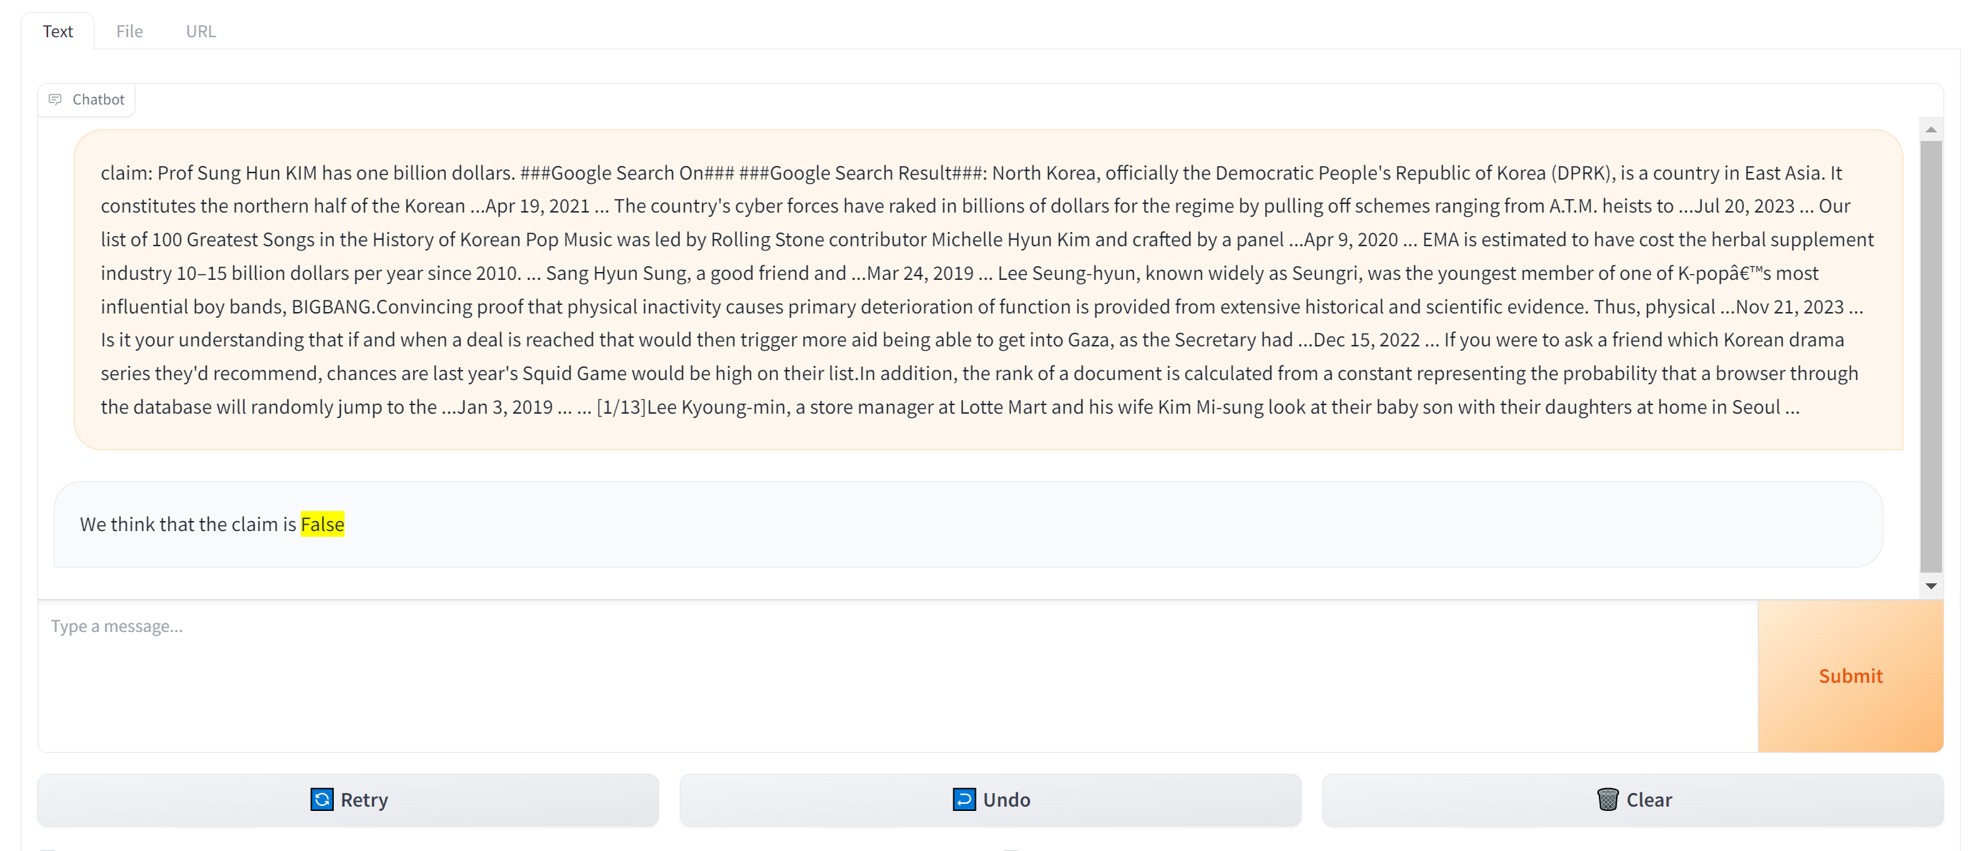
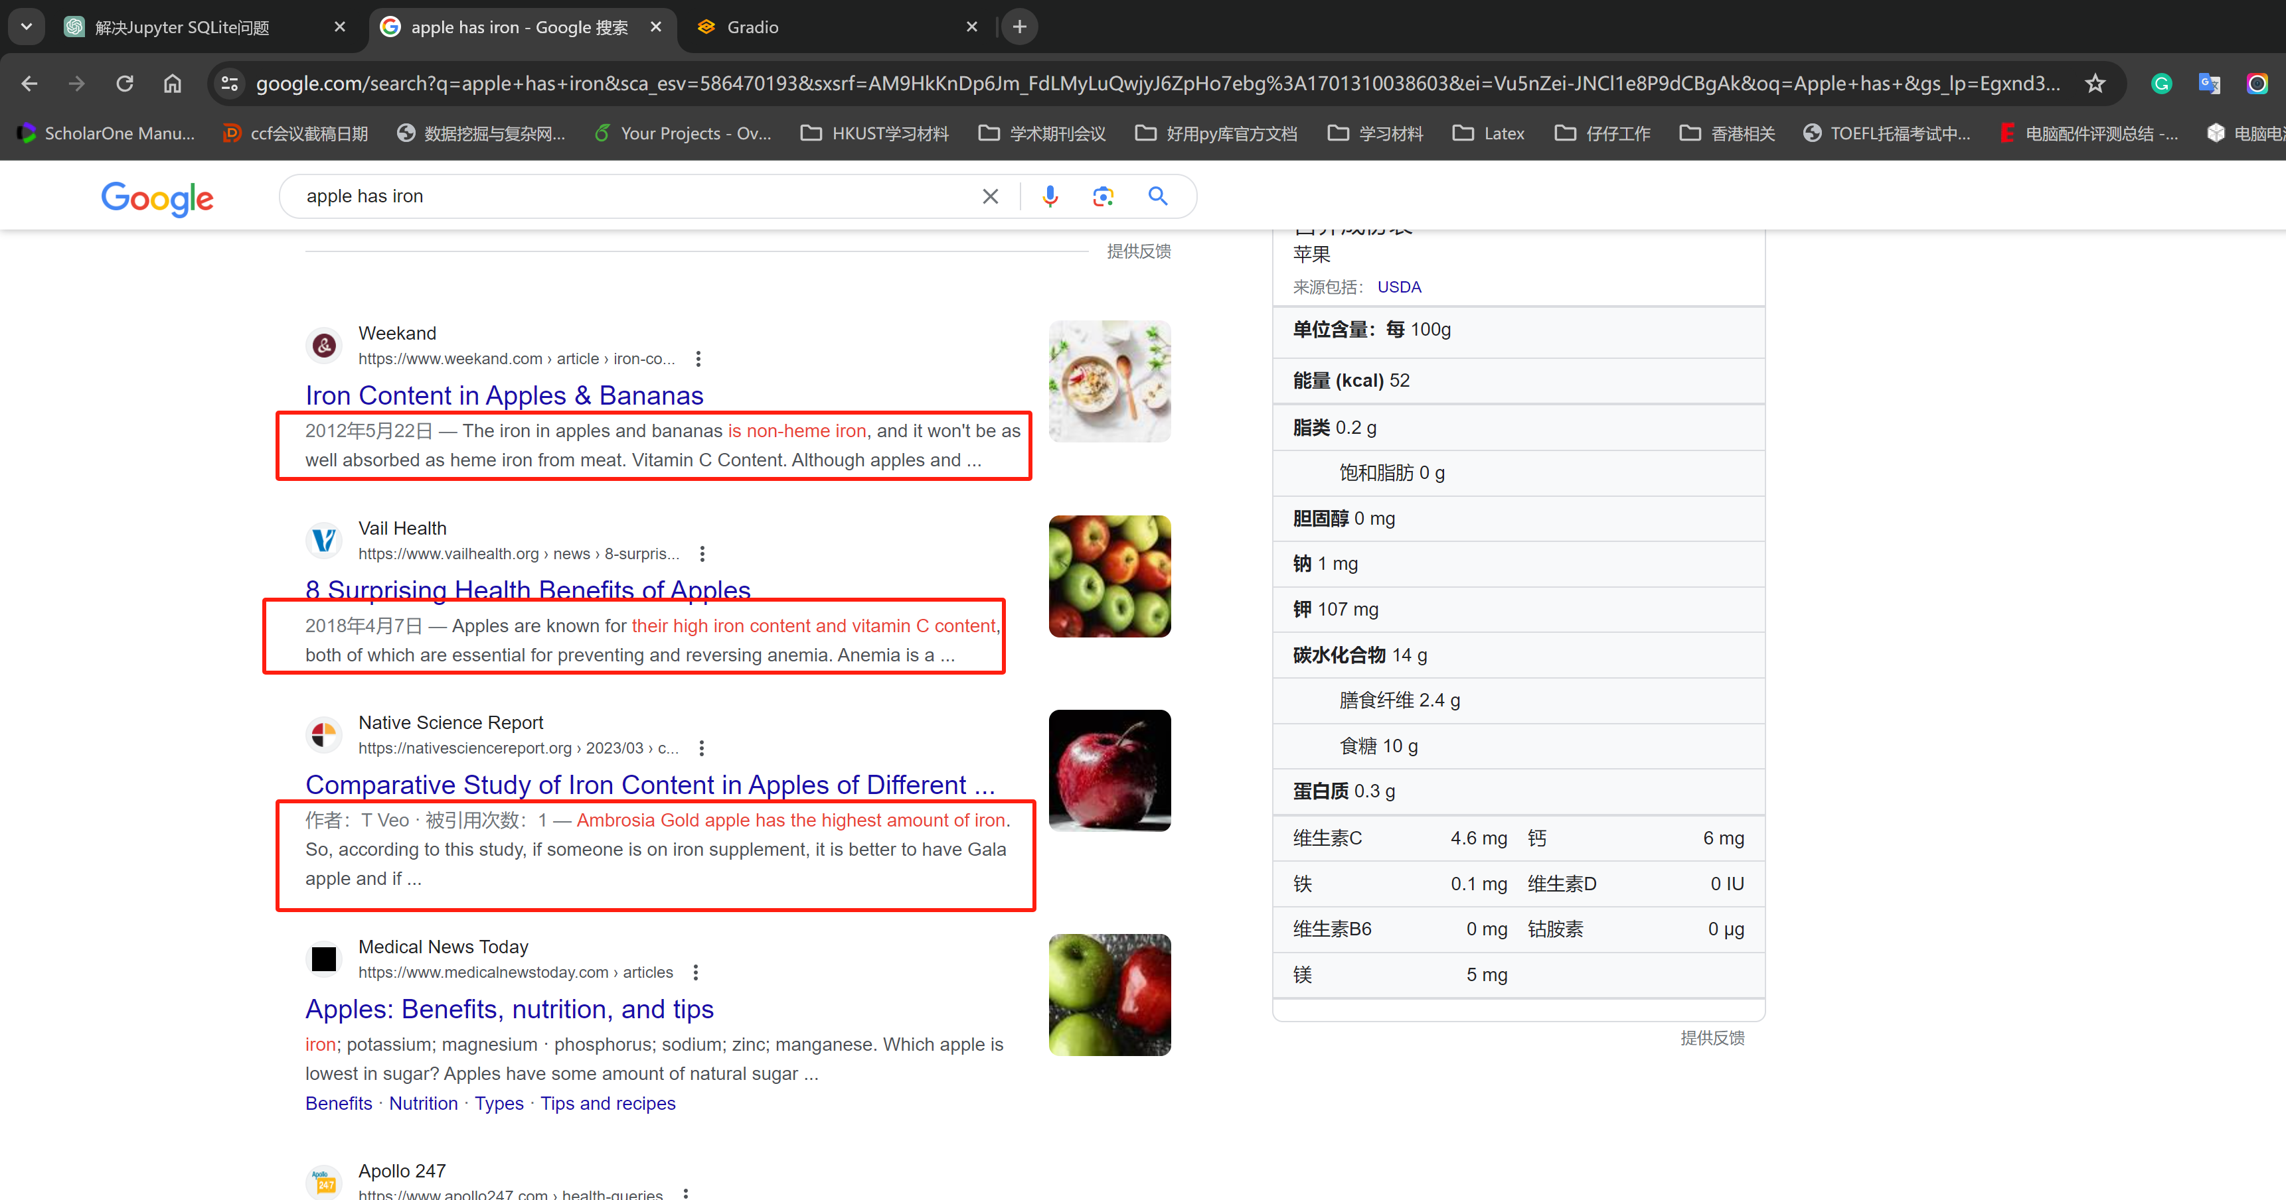
Demo Interface
Text Module: Users input claims only
5/8
HKUST(GZ) | Demo Interface
Notes:
Our demo can be divided into three modules. We offer different input modules to give the user a variety of choices.
For the text module, Users can input news claim, and our demo has built-in google search engine API to retrieve relevant news content according to the inputs submitted by users. Specifically, we mainly crawl snippets, which are usually short descriptions of web page content, and the search engine automatically extracts them from the web page according to the user's query, as the evidence for LLM to determine the truth of news assertions.
按空格 x2
In the results presentation, we highlight the results of the model's judgment, and can provide the evidence for the model's judgment.

Slide 7
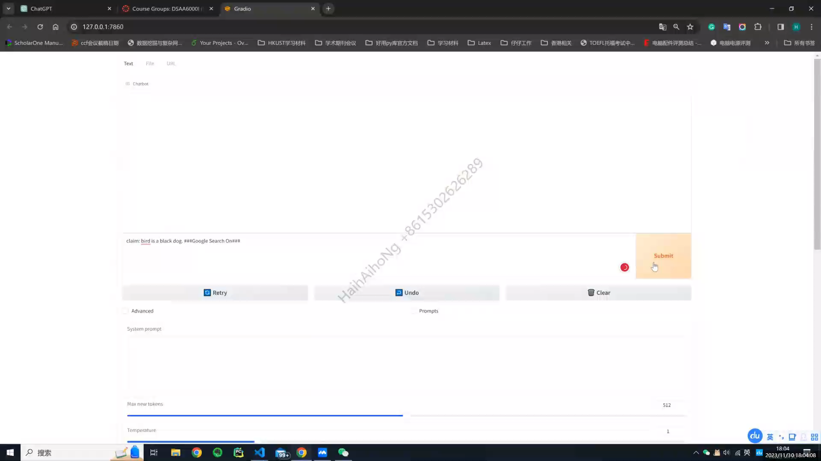
Demo Interface
6/8
HKUST(GZ) | Demo Interface
Notes:
播放视频

Slide 8
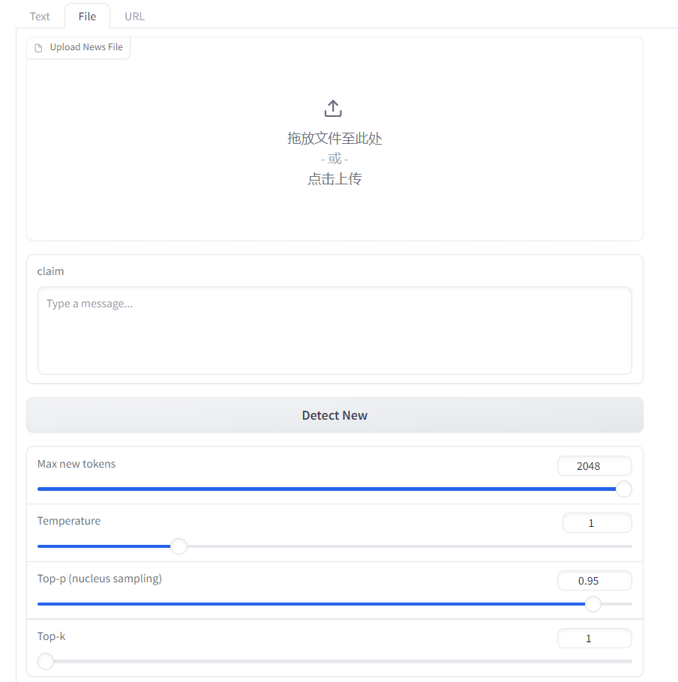
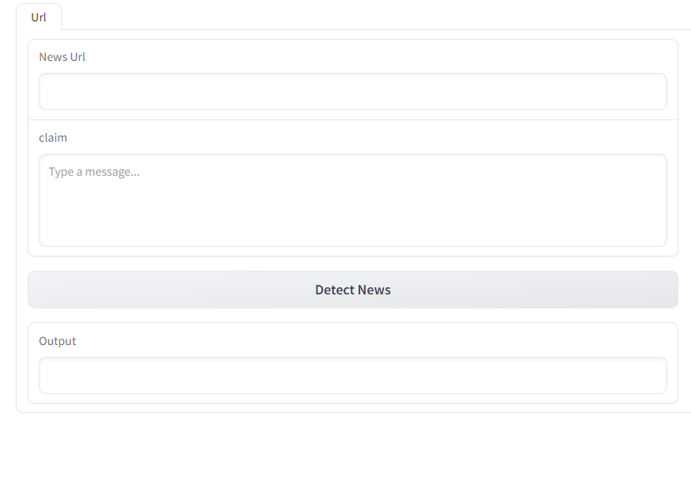
Demo Interface
7/8
HKUST(GZ) | Demo Interface
Notes:
Our demo also concludes file module. Users can provide news material files, as well as relevant news assertions, and our demo will determine the truth or falsity of the news assertions based on the news material
Similarly, the user can also provide news links and related news assertions, and our demo will automatically crawl the content corresponding to the webpage url to determine the truth of the assertions.

Slide 9
What We Learn
From the project:
We learned how to build the front-end UI of the simple app demo and how to plug in the back-end big language model into it.
We learned the underlying logic of the DeepSpeed training framework and some basic prompt formatting regulations for building fine-tune datasets.
Data Quality is very important for fine-tuning
HKUST(GZ) | Demo Interface | 8/8
Notes:
From the project. We learned how to build the front-end UI of the simple app demo and how to plug in the back-end big language model into it. We learned the underlying logic of the deepspeed training framework and some basic prompt formatting regulations for building fine-tune datasets, And understood the importance of fine-tune's data to the final result of the big language model demo.

Slide 10

Thanks for listening

